Slide 1

Hackathon App
Group A

Slide 2
The Team
George Brewster (Product Manager)
Travis Rinehart (Scrum Master)
Clinton Andrews
Amy Ly
Jason Hackleman
Joeseph Cutrono – stakeholder Ultimate Software

Slide 3
Hackathon App Progress
Ultimate Software hosts an internal hackathon for their employees and desires an app to help manage several aspects before and during the events. The following Features were attempted during Sprint 2:
Adding authentication support for users and admins.
Adding in ideas section including submitting an idea and viewing and “liking” submitted ideas.
Voting mechanism for projects including the voting action and admin maintenance of the votes.
Events: tracking events, adding to events, events schedule, and more.
Comments for both projects and ideas
FAQ section including FAQ response, answer identification and reporting.
Menu received updates due to new functionality added.

Slide 4
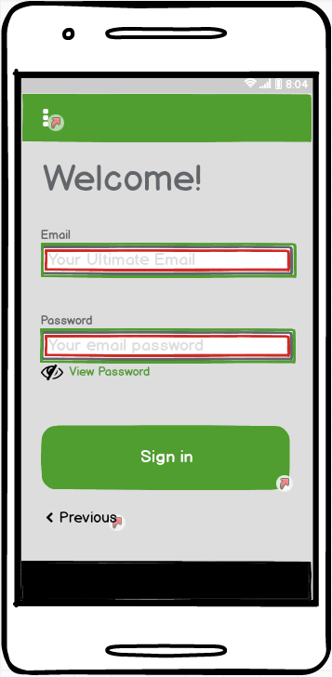
Sprint 2 - Authentication
The customer requested this feature be kept simple since they would most likely replace or build on what we introduce. This feature includes:
Basic identification of the username/e-mail to password
Peeking feature for password
Completes intro screens
Seeded with both basic users and admins

Slide 5
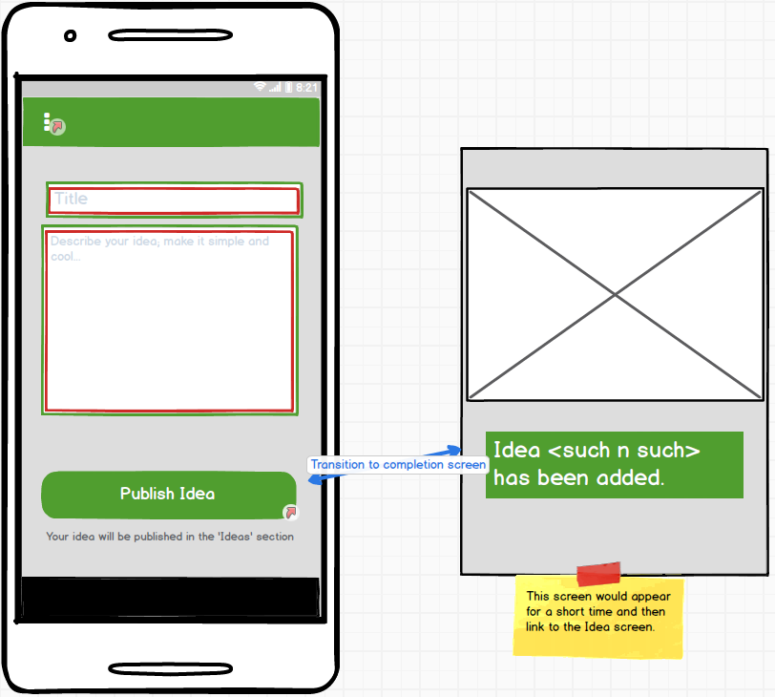
Sprint 2 - Ideas
Ideas are an area for the employees to add their ideas that they may not necessarily have all the pieces put together, but they are looking for support if others like or want to join in shaping it up to a project. The feature includes :
Adding of the title and description
Ideas added to menu system
My idea screen
Get involved functionality
“Like” selection feature

Slide 6
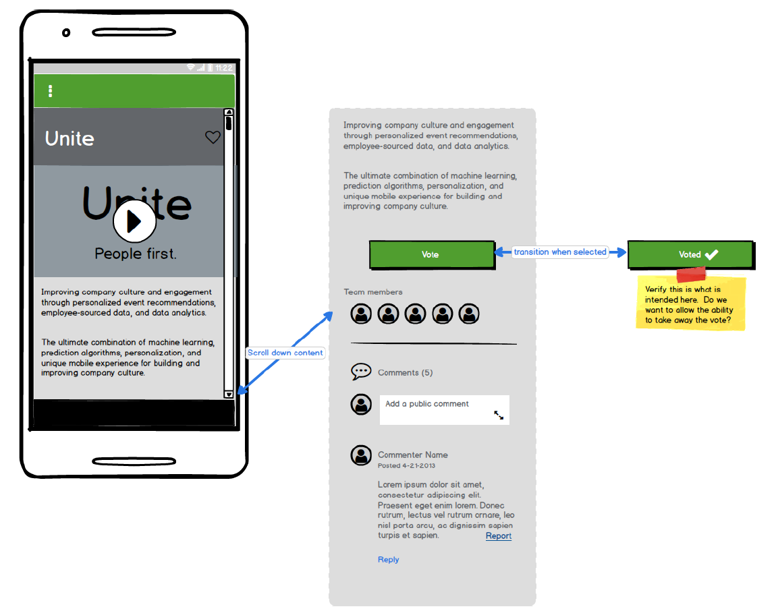

Sprint 2 - Voting
This feature allows users to vote for project and for admin to keep track of project votes
Admin view of vote results sorted by ascending and descending order
Vote/Unvote button functionality
Only allows users to vote for a project once

Slide 7
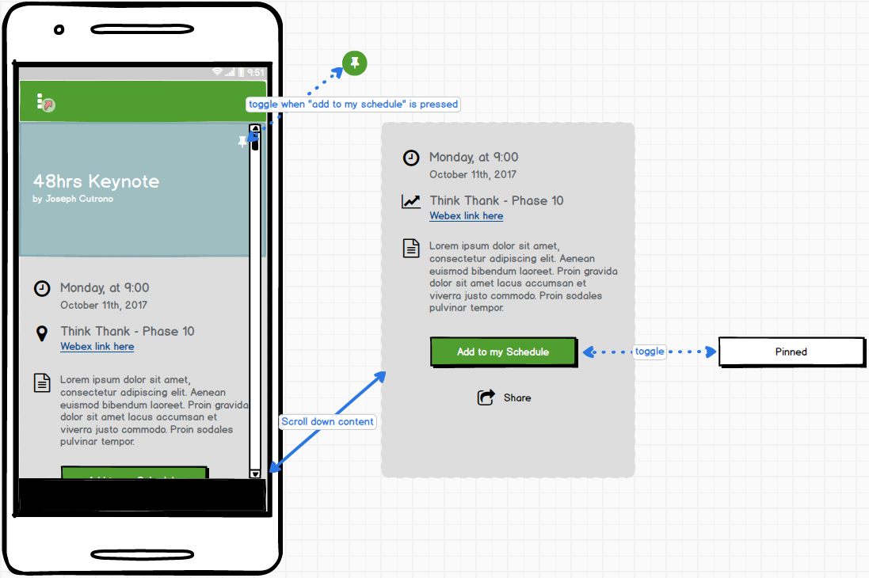
Sprint 2 - Events
Events are in two forms for this project. One, the Hackathon event itself as in the whole event. Two, the events that are occurring throughout a Hackathon such as lectures, games, etc. The events feature includes:
Two countdown timers, once for counting down to an event and one to calculate time left in a Hackathon.
Regional time – event schedule adjusts based on the location of the user.
Setup for admins to create an event
Display events in a schedule
Push notifications of upcoming events during a hackathon
Event screen for event details and pinning events in the schedule

Slide 8
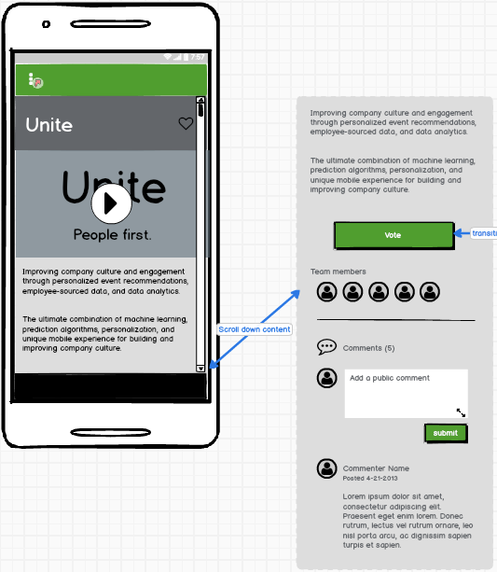
Sprint 2 - Comments
Comments are an added stream for both projects and ideas. This feature should allow a user to post a comment to the project or idea (add in the user profile pic or avatar later).
Comments contain User, date posted, and content
Comment counter kept near the section title.
Sorted list of comments by posted date.

Slide 9
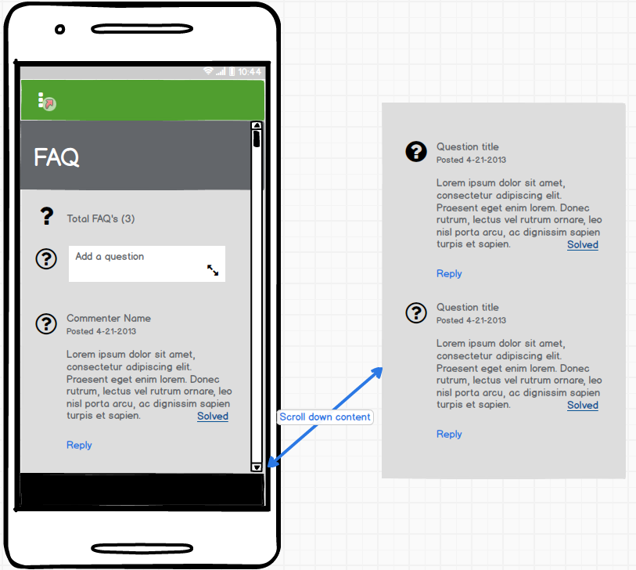
Sprint 2 - FAQ’s
FAQ’s allow the user to post questions, reply to questions, and report a question if needed.
FAQ’s contain User, date posted, and question with replies
FAQ counter kept near the section title.
Sorted list of FAQ’s by posted date.
Ability to mark a FAQ solved by the user who posted it.

Slide 10
Sprint 2 Summary
The team put in a strong effort and a lot of hard work this iteration. The following are the current conditions of the app and features that made it in:
Authentication: the ground work is there and is at the level expected for this sprint.
Ideas: All screens for setup of an Idea and displaying a single idea are here and are at the expected level for this sprint.
Voting: all voting functionality is present and usable. Admin screen can see projects in vote order. By category then vote order is in progress.
Events: Event timer is in place and events can be setup by the admin. Work is in progress on setting up the schedule.
Comments: front end features are nearing completion and functioning for both projects and ideas. Further work needs to be done to add avatars to the stream.
FAQ’s: Implementation of the FAQ screen and adding new questions is complete. Work in progress for replies and reporting.

Slide 11
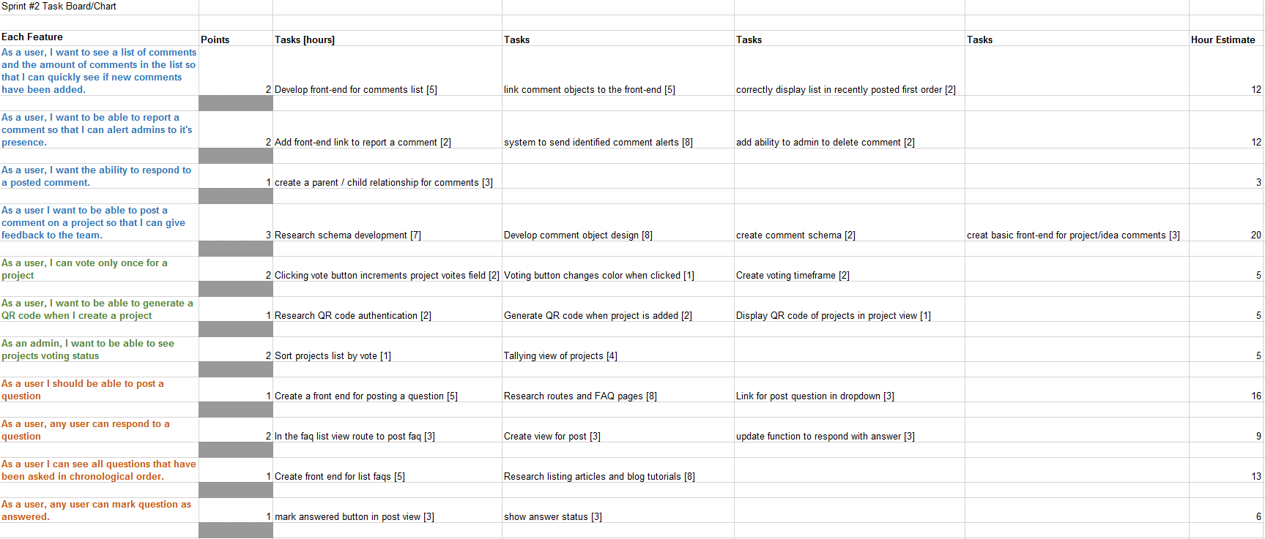
Burn-down Chart Snapshot

Slide 12
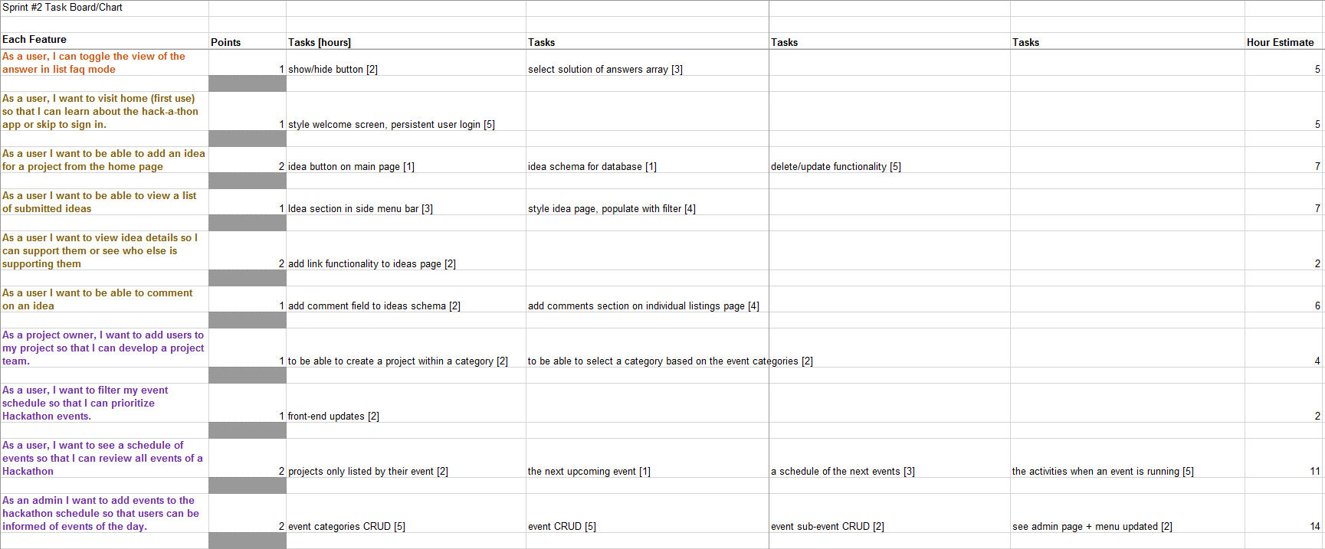
Burn-down Chart Snapshot (cont.)

Slide 13
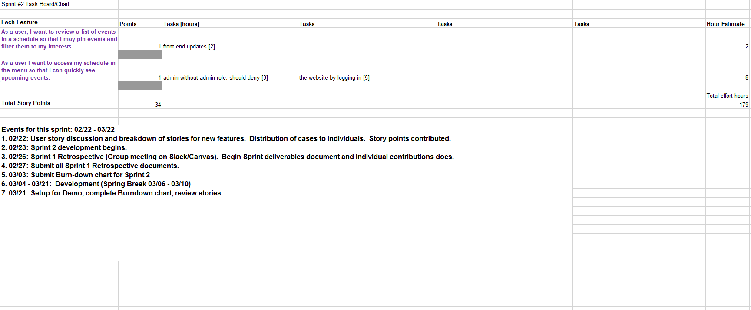
Burn-down Chart Snapshot (cont.)

Slide 14
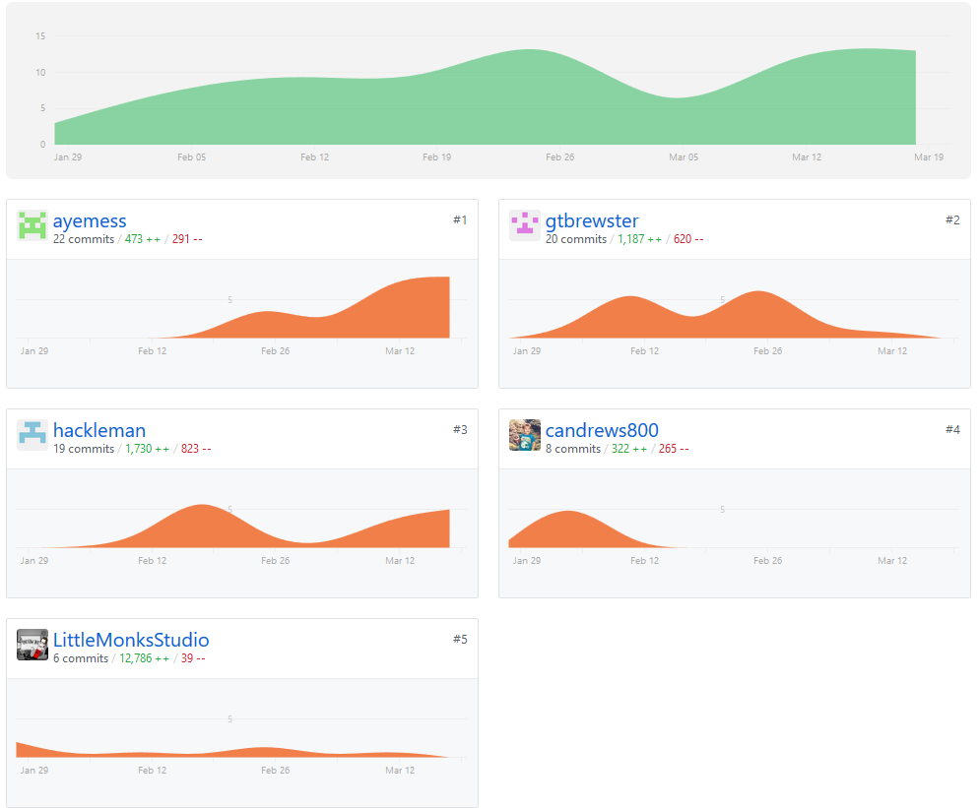
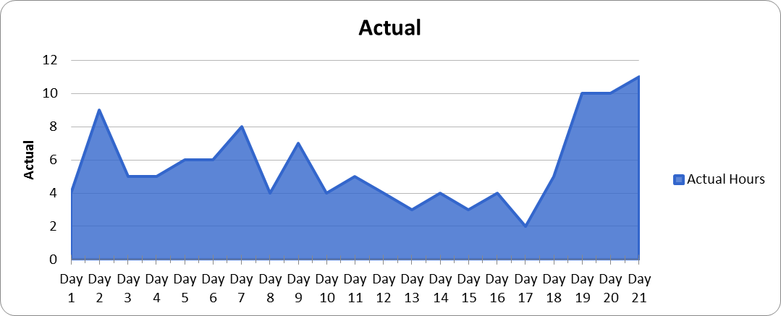
GitHub Charts & Burndown Chart

Slide 15
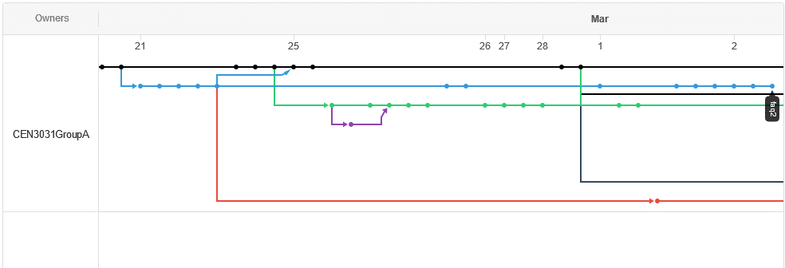
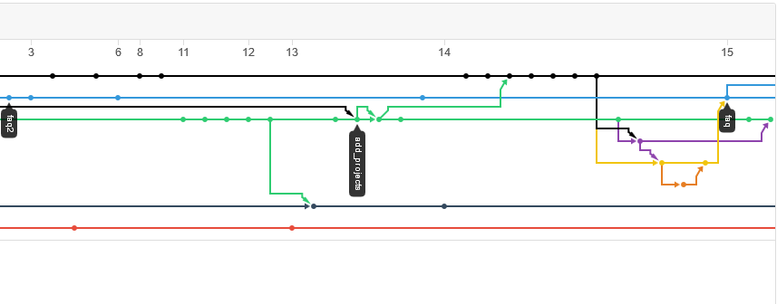
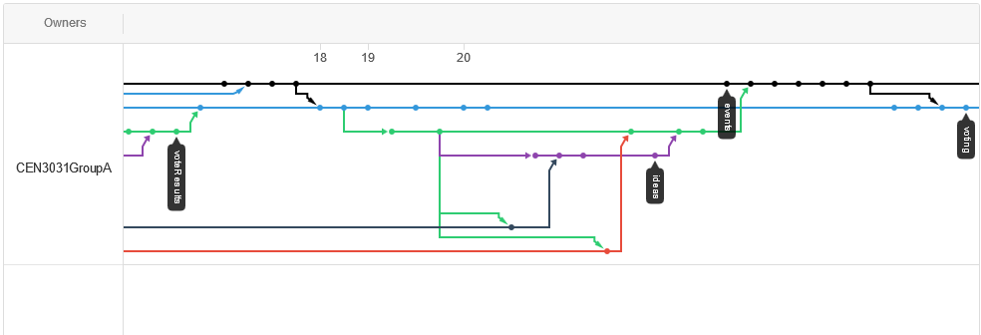
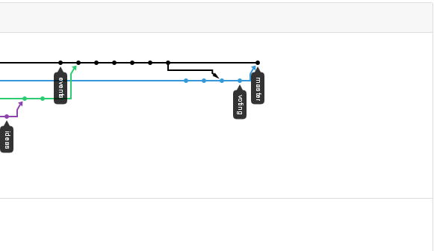
GitHub Activity

Slide 16
Testing and Release
At this point, testing has been done through peer review and running through grunt/Heroku from branches. No implementation of testing via test code has been developed yet.
Most features have a good start and the software continues to work. There are a few bugs that will need to be addressed and small amount of functionality to create. The last Sprint will be mainly focused on cleaning up features and adding polish to the already implemented features (branding, color schemes and overall unifying the design.)
A released version of the currently working App can be found here:
https://still-eyrie-27550.herokuapp.com/
You can use travis+admin@gmail.com and password = 1234 to login

